Slide 1




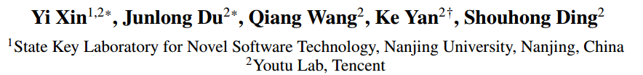



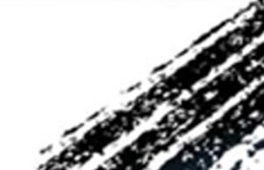

ATAI
Advanced Techniqueof Artificial Intelligence
ATAI
ChongqingUniversity _{AdvancedTechniqueof}
of Technology Artificial Intelligence
Chongqing University of
Technology
Chongqing University ^{ATAI}
_{of Technology} Advanced Techniqueof
Artificial Intelligence
Chongqing University of Technology
Chongqing University of Technology
MmAP:Multi-Modal Alignment Prompt for
Cross-Domain Multi-Task Learning
Code: null
2024.9.12•ChongQing
—— AAAI 2024
Reported by LeLe Ren
1
Notes:
人工智能促进会：
用于跨领域多任务学习的多模态对齐提示

Slide 2

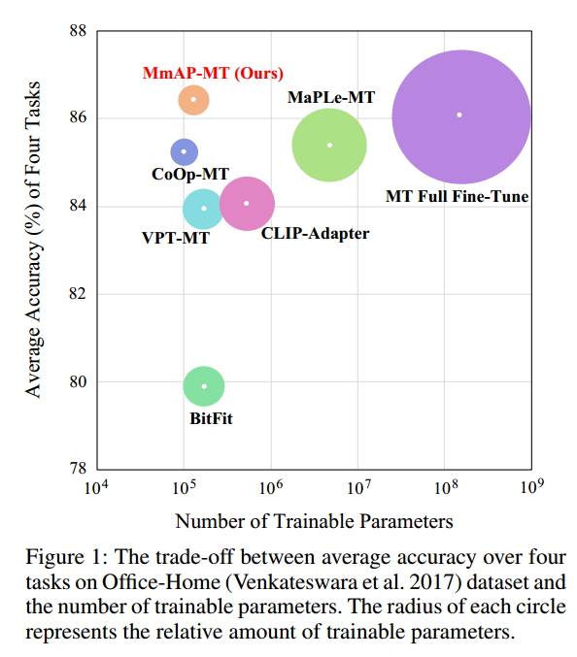
ATAI
AdvancedTechniqueof
Artificial Intelligence
ATAI
ChongqingUniversity _{AdvancedTechniqueof}
of Technology Artificial Intelligence
ChongqingUniversity of Technology
Motivation
（1）parameter-efficient transfer learning methods have been extensively explored with CLIP for adapting to downstream tasks, where prompt tuning showcases strong potential. Nevertheless, these methods solely fine-tune a single modality(text or visual), disrupting the modality structure of CLIP. In this paper, author first propose Multi-modal Alignment Prompt (MmAP) for CLIP, which aligns text and visual modalities during fine-tuning process. Creatively using the group-shared MmAP to maximize the complementarity between highly similar tasks, while preserving the uniqueness of each task by assigning a task-specific MmAP to each.

Slide 3

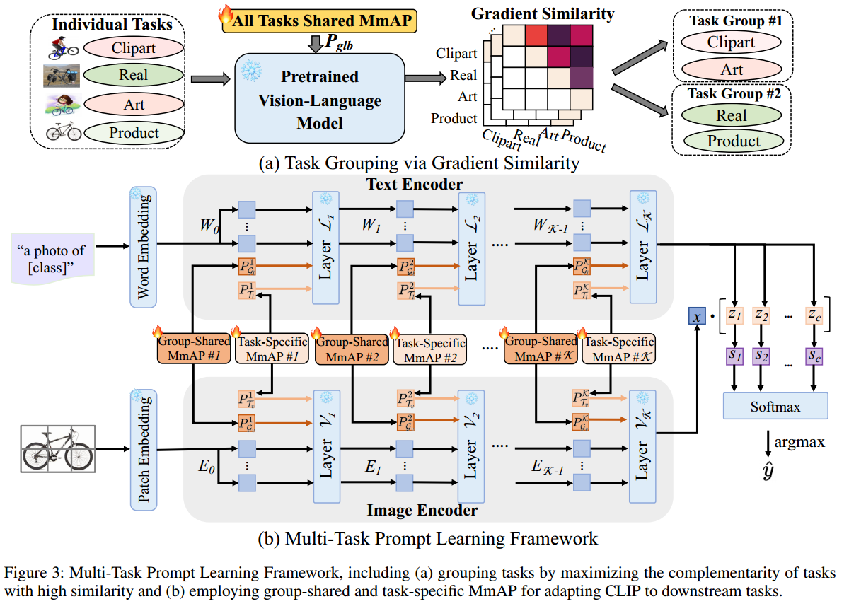
ChongqingUniversity of Technology
ATAI
AdvancedTechniqueof
Artificial Intelligence
ATAI
ChongqingUniversity _{AdvancedTechniqueof}
of Technology Artificial Intelligence
Overview
Notes:
展示了如何通过梯度相似性来分组任务，以最大化具有高相似性任务之间的互补性。
individual tasks中有4个独立的任务
Clipart 图像可能需要模型识别简化的形状和颜色。
Real 任务可能需要模型处理复杂的背景和光照变化。
Art 任务可能要求模型理解艺术表现和风格差异。
Product 任务可能需要模型识别特定产品的细节和品牌特征

Slide 4

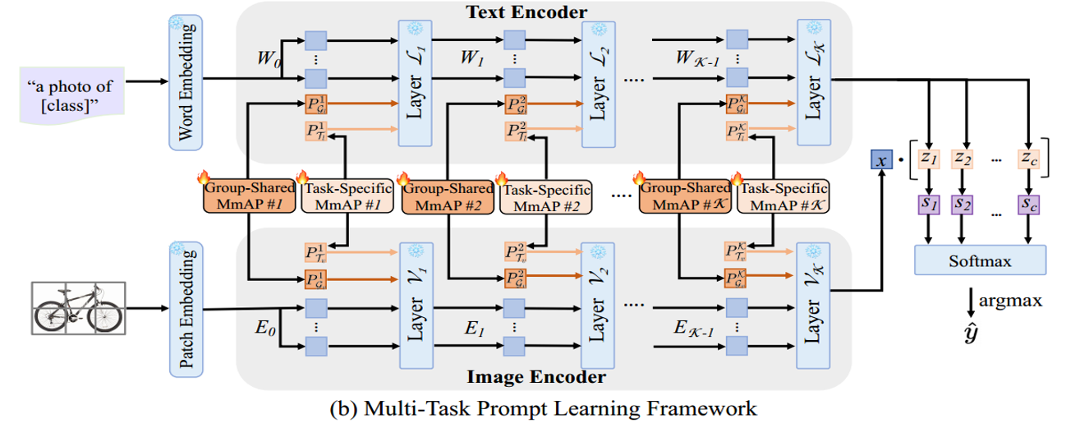




ChongqingUniversity of Technology
ATAI
AdvancedTechniqueof
Artificial Intelligence
ATAI
ChongqingUniversity _{AdvancedTechniqueof}
of Technology Artificial Intelligence
Method

Slide 5

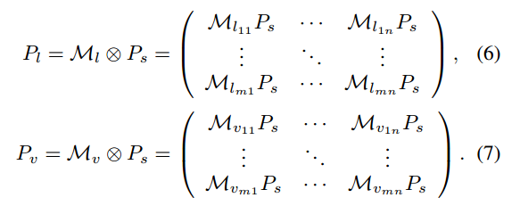
ChongqingUniversity of Technology
ATAI
AdvancedTechniqueof
Artificial Intelligence
ATAI
ChongqingUniversity _{AdvancedTechniqueof}
of Technology Artificial Intelligence
Method

Slide 6
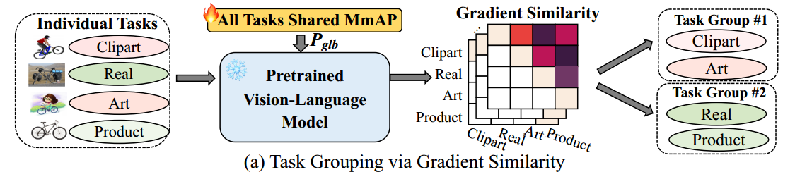
ChongqingUniversity of Technology
ATAI
AdvancedTechniqueof
Artificial Intelligence
ATAI
ChongqingUniversity _{AdvancedTechniqueof}
of Technology Artificial Intelligence
Method

Slide 7
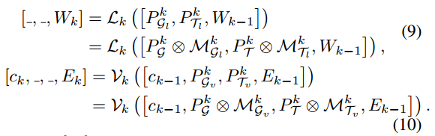
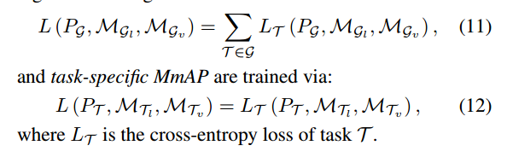
ChongqingUniversity of Technology
ATAI
AdvancedTechniqueof
Artificial Intelligence
ATAI
ChongqingUniversity _{AdvancedTechniqueof}
of Technology Artificial Intelligence
Method

Slide 8

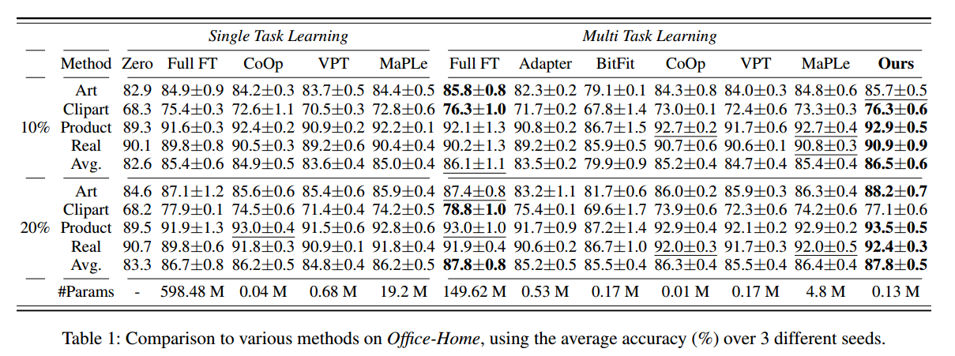
ATAI
AdvancedTechniqueof
Artificial Intelligence
ATAI
ChongqingUniversity _{AdvancedTechniqueof}
of Technology Artificial Intelligence
ChongqingUniversity of Technology
Experiments

Slide 9
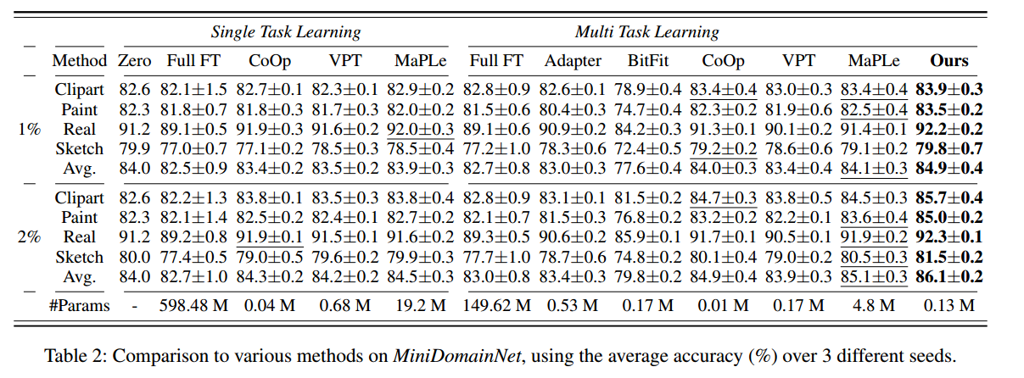
ATAI
AdvancedTechniqueof
Artificial Intelligence
ATAI
ChongqingUniversity _{AdvancedTechniqueof}
of Technology Artificial Intelligence
ChongqingUniversity of Technology
Experiments

Slide 10
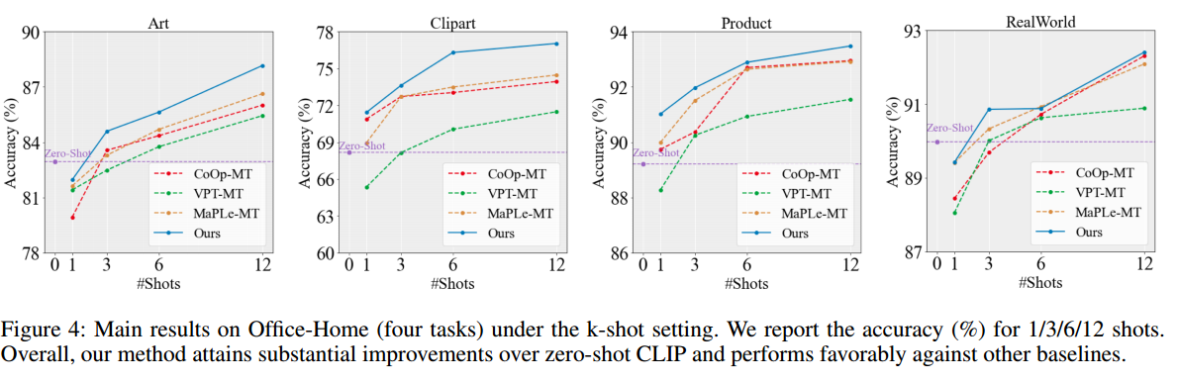
ATAI
AdvancedTechniqueof
Artificial Intelligence
ATAI
ChongqingUniversity _{AdvancedTechniqueof}
of Technology Artificial Intelligence
ChongqingUniversity of Technology
Experiments

Slide 11
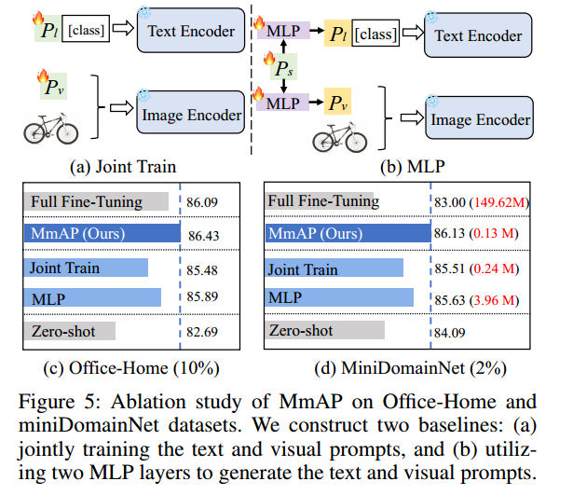
ATAI
AdvancedTechniqueof
Artificial Intelligence
ATAI
ChongqingUniversity _{AdvancedTechniqueof}
of Technology Artificial Intelligence
ChongqingUniversity of Technology
Experiments

Slide 12


ChongqingUniversity of Technology
ATAI
AdvancedTechniqueof
Artificial Intelligence
ATAI
ChongqingUniversity _{AdvancedTechniqueof}
of Technology Artificial Intelligence
Thanks!

